Slide 1
IEEE RAS Standards
Craig Schlenoff, PhD
Group Leader, Cognition and Collaborative Systems Group
Acting Group Leader, Sensing and Perception Systems Group
Associate Program Manager, Measurement Science for Manufacturing Robotics
Project Leader, Agility Performance of Robotics Systems Project
Project Leader, Embodied AI and Data Generation for Manufacturing Robotics Project
National Institute of Standards and Technology
Associate Vice President for Standardization
Chair, Standing Committee for Standards Activities
Vice Chair, IEEE 1872.1 Robot Task Representation Working Group
IEEE Robotics and Automation Society

Slide 2
What does it take to verify an autonomous system?
What is an autonomous system?
A system performing a given task in which the system solves the task without human intervention while adapting to operational and environmental conditions.
How do you verify the behavior of an autonomous system (one approach)?
Formally model relevant aspects of the system including the environment, the autonomous system itself, and the tasks/capabilities that it is able to perform
Develop an appropriate architecture
Gather training data
Use formal verification techniques to assess the system

Slide 3
IEEE RAS Standards
IEEE 1872- 2015 - IEEE Standard Ontologies for Robotics and Automation
IEEE 1873-2015 – IEEE Standard for Robot Map Data Representation for Navigation
IEEE 1872.1 - Robot Task Representation
IEEE 1872.2 - Standard for Autonomous Robotics (AuR) Ontology
IEEE 2751 - 3D Map Data Representation for Robotics and Automation
IEEE 7007 - Ontological Standard for Ethically Driven Robotics and Automation Systems
IEEE 7008 - Standard for Ethically Driven Nudging for Robotic, Intelligent and Autonomous Systems

Slide 4
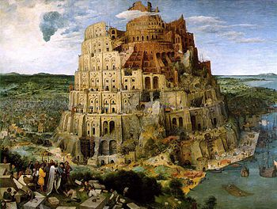
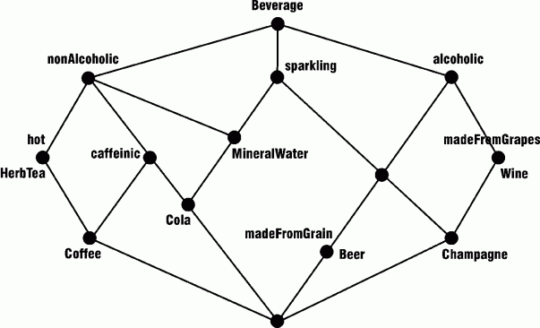
What is an Ontology?
“a specification of a conceptualization”*
Ontologies explicitly represent key concepts, their properties, their relationships, and their rules and constraints.
Ontologies often focus more heavily on the meaning of concepts as opposed to terms that are used to represent them
Vocabulary + Structure = Taxonomy
Taxonomy + (Relationships and Constraints) = Ontology
*Tom Gruber, Stanford Univ.

Slide 5
Why do ontologies matter?
Ontologies represent knowledge in a formal way.
Different from taxonomies, ontologies provide a much richer set of relationships and also allow for constraints and rules to govern those relationships.
Formal ontologies typically allow us to encode the knowledge in a machine readable format.
Most importantly (for us), ontologies allow system to reason over information.

Slide 6
Formalities of Knowledge Representations
ad hoc Hierarchies
(Wikipedia)
XML
Schema
Description Logics
(DAML+OIL)
structured
Glossaries
formal
Taxonomies
Terms
XML DTDs
Thesauri
‘ordinary’
Glossaries
Principled, informal hierarchies
Data Models
(UML, STEP)
General
Logic
Data
Dictionaries
(EDI)
Frames
(OKBC)
DB
Schema
OWL
IEEE ORA
Group
Glossaries & Data Dictionaries
Thesauri, Taxonomies
MetaData,
XML Schemas, & Data Models
Formal Ontologies & Inference

Slide 7
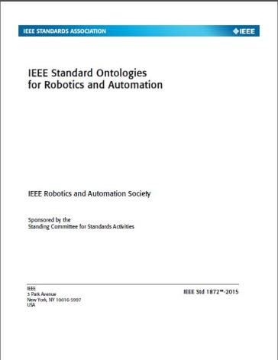
Core Ontologies for Robotics and Automation Standard
IEEE 1872 -Core Ontology for Robotics and Automation (CORA)
“… allows for the representation of, reasoning about, and communication of knowledge in the robotics and automation domain.”
http://standards.ieee.org/findstds/standard/1872-2015.html
First ontology-based IEEE RAS standard
IEEE Ontologies for Robotics and Automation Standards Working Group
November 2011 – Became a working group
July 2014 – Initial standard applied to robots at NIST and Georgia Tech
April 2015 – CORA Becomes a Standard (unanimous approval from ballot group)
175 members representing 23 countries
~50% educational institutions, ~25% industry, ~25% government
~50% US, ~50% non-US
C. I. Schlenoff, "Let’s Talk, Robots" Scientific Computing Magazine, Scientific Computing, 100 Enterprise Dr. Suite 600, Rockaway, NJ, 07866, United States, (21-Nov-2016)

Slide 8
IEEE 1872-2015
Notes:
Ethical issues no centro..
Quem pode atacar, regular, quem é afetado, ..
soluções

Slide 9
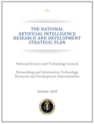
IEEE 1872-2015
IEEE-SA Emerging Technology Award
for “developing the Core Ontologies for Robotics and Automation standard, which is the first RAS standard and one of the first ontology-based IEEE standards.”
Mentioned in Former President Obama’s "The National Artificial Intelligence Research and Development Strategic Plan"
“One example of an AI-relevant standard that has been developed is P1872-2015 (Standard Ontologies for Robotics and Automation), developed by the Institute of Electrical and Electronics Engineers (IEEE). This standard provides a systematic way of representing knowledge and a common set of terms and definitions. These allow for unambiguous knowledge transfer among humans, robots, and other artificial systems, as well as provide a foundational basis for the application of AI technologies to robotics.”
Notes:
Ethical issues no centro..
Quem pode atacar, regular, quem é afetado, ..
soluções

Slide 10
P1872.1: Robot Task Representation
Name:
Robot Task Representation
Purpose:
Developing a knowledge representation that addresses robot task structure, with decomposition into subclasses, categories, and/or relations. It includes attributes, both common across tasks and specific to particular tasks and task types. The purpose of this knowledge representation is to provide a common way of representing tasks across domains and sub-domains, addressing both the relationships between tasks and platforms and the relationships between tasks and users
Chair : Stephen Balakirsky (GTRI)
Vice-Chair: Craig Schlenoff (NIST)
Secretary: Signe Redfield (NRL)
Notes:
The concrete decomposition from goali to sub-goalsii that enable the robot to accomplish the user’s goalsi. This term is particularly problematic, since practitioners in different fields tend to define it differently, and even within any given field, its usage is arbitrary.
A restatement of the goal from the robot’s perspective. If the goali is the expression of what the operator wants done, the taski is how the robot interprets it (i.e., task planning). Subtasks can be defined to whatever depth it is necessary. Tasks and sub-tasks are accomplished via behaviors and actions.
A lower or higher level behavior. Within a given discussion, it is common for taski to be used as a generic term to enable individuals to differentiate between the behavior or action under discussion and other lower or higher level actions. This is particularly relevant during taski decomposition/taski allocation discussions, where the decomposition process results in sub-tasks that, from the perspective of the original taski, are synonymous with the actions used to accomplish them.

Slide 11
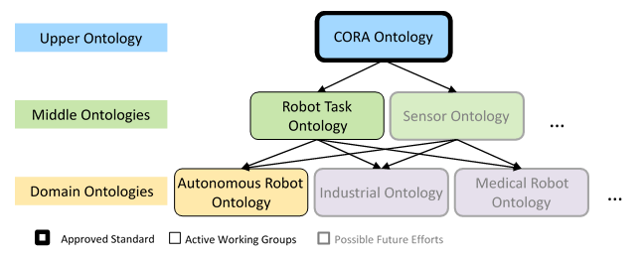
P1872.1: Robot Task Representation
Notes:
Ethical issues no centro..
Quem pode atacar, regular, quem é afetado, ..
soluções

Slide 12
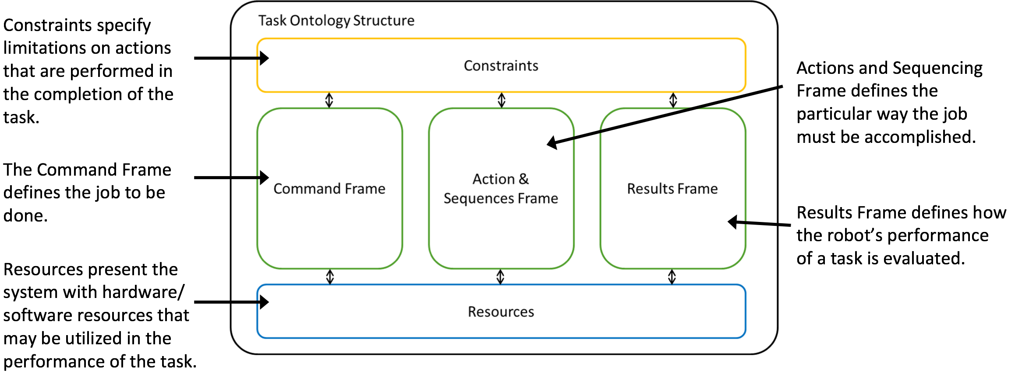
P1872.1: Robot Task Representation
Structure of the IEEE Robotics and Automation Society’s Task Ontology
Notes:
Ethical issues no centro..
Quem pode atacar, regular, quem é afetado, ..
soluções

Slide 13
P1872.1: Robot Task Representation
Task Description Terminology – describes what the user or operator needs to get done
Goal – What the robot is attempting to accomplish
Task – A task is commanded to zero or more resources to achieve an intended outcome through zero or more actions.
Command – A task provided by another agent
Task Property Terminology – defines properties of the job
Constraint – limit the ways in which the robot can complete the task
Evaluation – how the robot’s performance of the task is evaluated
Task Implementation Terminology – the aspects of the task that relate to specific things that must be accomplished
Action – An implementation of a command with the purpose of changing or maintaining the system state.
Capability – actions in the abstract
Control Construct – A non-empty set of actions and their ordering relations
Result - ?
Task Context Terminology - enables the user to define relevant properties of the context in which the task is expected to take place
Environment – things that are not part of the robot system
Platform – things that are part of the robot itself
Resource - ?
System State - ?
Notes:
Ethical issues no centro..
Quem pode atacar, regular, quem é afetado, ..
soluções

Slide 14
How To Get Involved
Officially became a working group: February 2017
Total Members (52), Voting Members (20)
Working Status:
Outline for the standards document has been created
Leadership assignments have been made for sections of the outline
Bi-weekly telecons to discuss each section and begin writing formal document
Target date for standard submission: Draft published December 2019
How to get involved:
Talk to Steve, Signe, or me during this meeting
Email Stephen Balakirsky (stephen.balakirsky@gtri.gatech.edu)
All are welcome!

Slide 15
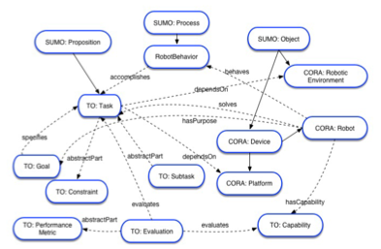
Future IEEE Standard : P1872.1
Notes:
Ethical issues no centro..
Quem pode atacar, regular, quem é afetado, ..
soluções

Slide 16
Future IEEE Standard : P1872.2
Name
IEEE Standard for Autonomous Robotics (AuR) Ontology
Purpose
This standard is a logical extension to IEEE 1872-2015 Standard for Ontologies for Robotics and Automation. The standard extends the CORA ontology by defining additional ontologies appropriate for Autonomous Robotics (AuR) relating to:
The core design patterns specific to AuR in common R&A sub-domains;
General ontological concepts and domain-specific axioms for AuR; and
General use cases and/or case studies for AuR.
Chair: Howard Li (UNB, Canada)
Notes:
Ethical issues no centro..
Quem pode atacar, regular, quem é afetado, ..
soluções

Slide 17
Future IEEE Standard : P1872.2
Motivation
This standard intend to represent the knowledge needed to build autonomous systems comprised of robots that can operate in all classes of unstructured environments- including, but not limited to, aerial, ground, surface, underwater and space robots
It will allow for unambiguous identification of the basic hardware and software components necessary to provide a robot or a group of robots with autonomy
Notes:
Ethical issues no centro..
Quem pode atacar, regular, quem é afetado, ..
soluções

Slide 18
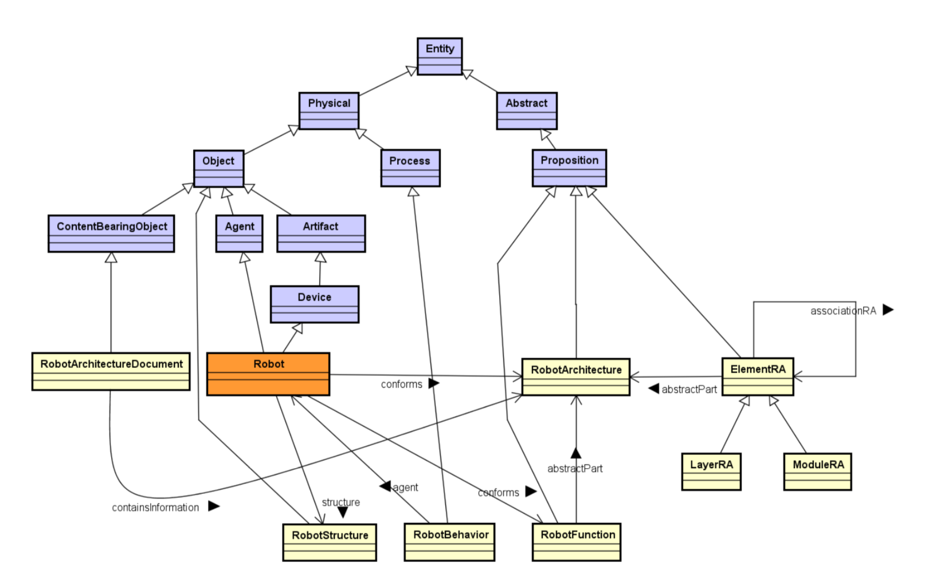
Future IEEE Standard : P1872.2
Notes:
Ethical issues no centro..
Quem pode atacar, regular, quem é afetado, ..
soluções

Slide 19
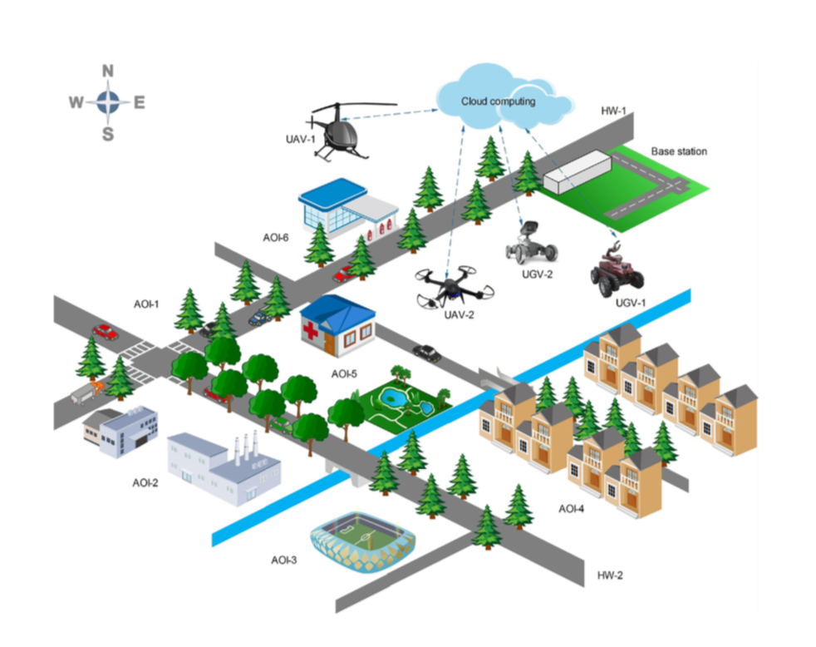
Future IEEE Standard : P1872.2
UAVs and UGVs in the Cloud Robotics Scenario.
Notes:
Ethical issues no centro..
Quem pode atacar, regular, quem é afetado, ..
soluções

Slide 20
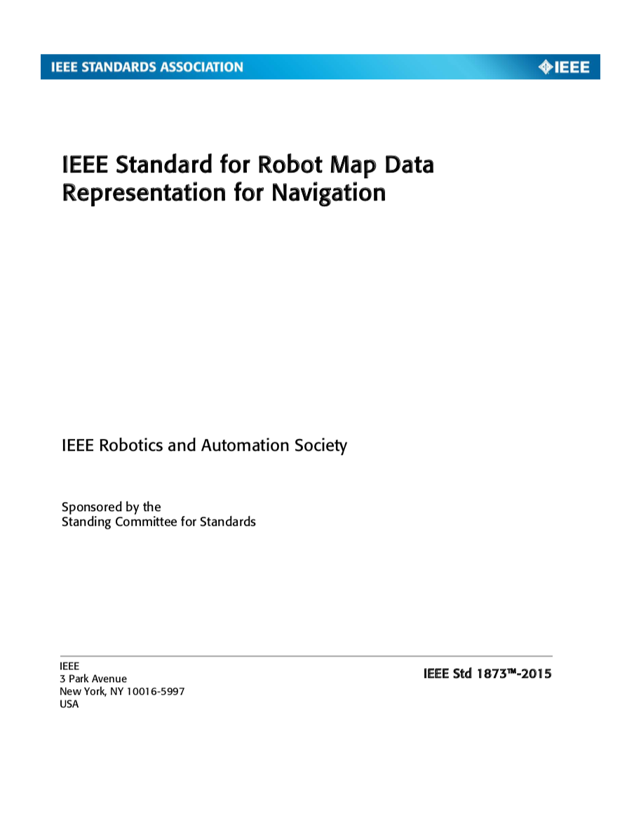
Standard : IEEE 1873-2015
Name :
IEEE Standard for Robot Map Data Representation for Navigation
Purpose
This standard provides specifications for representing 2D metric and topological maps. This standard defines a recommended format for exchanging map data among robots, computers, and other devices. The map representation format specified by this standard only considers static maps; in other words, moving objects are not explicitly represented in the maps. Additionally, no limit is placed on geographic scale or sensor modalities in applying this standard.
Chair: Wonpil Yu (ETRI, Korea)
Vice-chair: Francesco Amigoni (Politecnico di Milano,Italy)
Notes:
Ethical issues no centro..
Quem pode atacar, regular, quem é afetado, ..
soluções

Slide 21
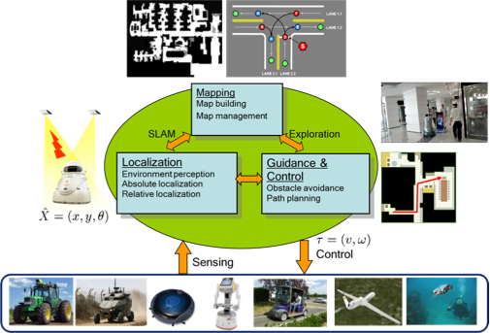
Standard : IEEE 1873-2015
Autonomous robots have their own internal representations of space.
The IEEE 1873-2015 standard is used ONLY to represent maps for data exchange (e.g., sharing maps). It does not intend to substitute internal representations.
Benefits:
Benchmarking
Facilitating development and deployment of robotic applications
Reducing development and deployment costs
Notes:
Ethical issues no centro..
Quem pode atacar, regular, quem é afetado, ..
soluções

Slide 22
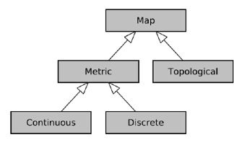
Standard : IEEE 1873-2015
Types of maps represented by the standard
Notes:
Ethical issues no centro..
Quem pode atacar, regular, quem é afetado, ..
soluções

Slide 23
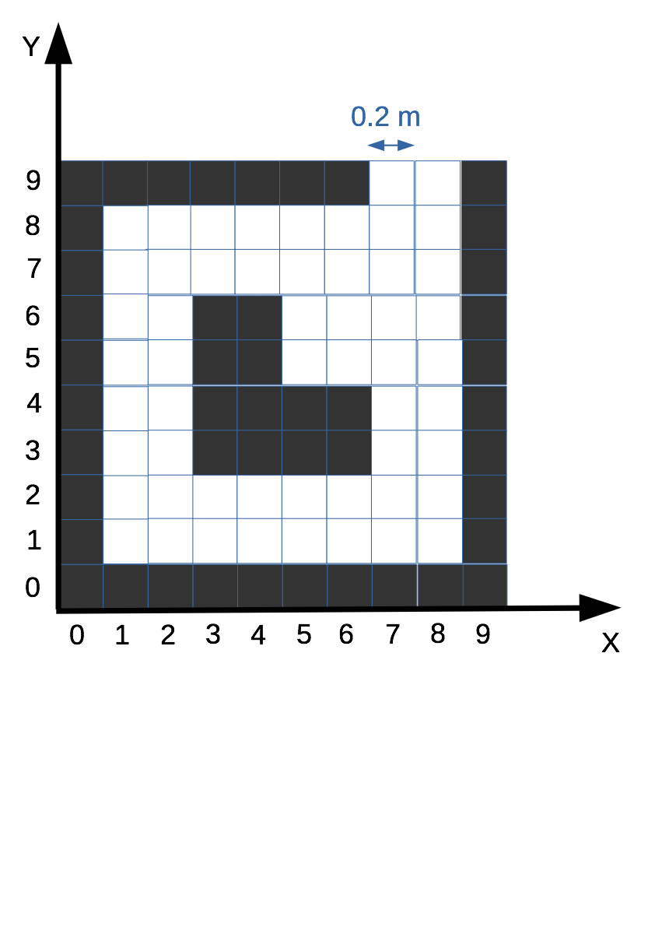
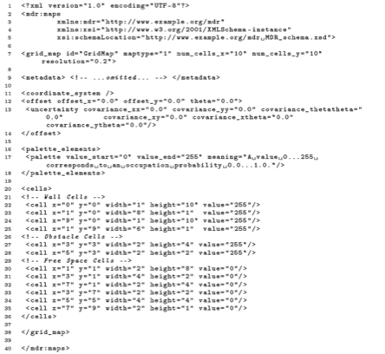
Example : Grid Map
Notes:
Ethical issues no centro..
Quem pode atacar, regular, quem é afetado, ..
soluções

Slide 24
Future Standard : IEEE P2751
Name
IEEE 3D Map Data Representation for Robotics and Automation
Purpose
This standard extends the IEEE 1873-2015 Standard for Robot Map Data Representation from two-dimensional (2D) maps to three-dimensional (3D) maps. The standard develops a common representation and encoding for 3D map data, to be used in applications requiring robot operation, like navigation and manipulation, in all domains (space, air, ground/surface, underwater, and underground). The standard encoding is devoted to exchange map data between robot systems, while allowing robot systems to use their private internal representations for efficient map data processing. The standard places no constraints on where map data comes from nor on how maps are constructed.
Chair: Francesco Amigoni (Politecnico di Milano,Italy)
Vice-chair: Tomasz Kucner (Örebro University, Sweeden)
Notes:
Ethical issues no centro..
Quem pode atacar, regular, quem é afetado, ..
soluções

Slide 25
Future Standard : IEEE P2751
3D Maps included in the Standard
Point clouds, grids (voxel maps, including octrees) and polygonal meshes.
Each maps type has elements and properties that can be mandatory or optional. For example, a grid is represented by:
voxels (with coordinates and properties, like occupancy)
resolution (length of the voxel edge)
size (number of voxels)
Notes:
Ethical issues no centro..
Quem pode atacar, regular, quem é afetado, ..
soluções

Slide 26
Future Standard : IEEE P7007
Name
IEEE SA/RAS P7007- Ontological Standard for Ethically Driven Robotics and Automation Systems
Purpose
The standard establishes a set of definitions and their relationships that will enable the development of Robotics and Automation Systems in accordance with worldwide Ethics and Moral theories, with a particular emphasis on aligning the ethics and engineering communities to understand how to pragmatically design and implement these systems in unison. These definitions allow for a precise communication among global experts of different domains that includes Robotics, Automation and Ethics
Chair: Edson Prestes (UFRGS, Brazil)
Vice-chair: Sandro Fiorini (UPEC, France)
Notes:
Ethical issues no centro..
Quem pode atacar, regular, quem é afetado, ..
soluções

Slide 27
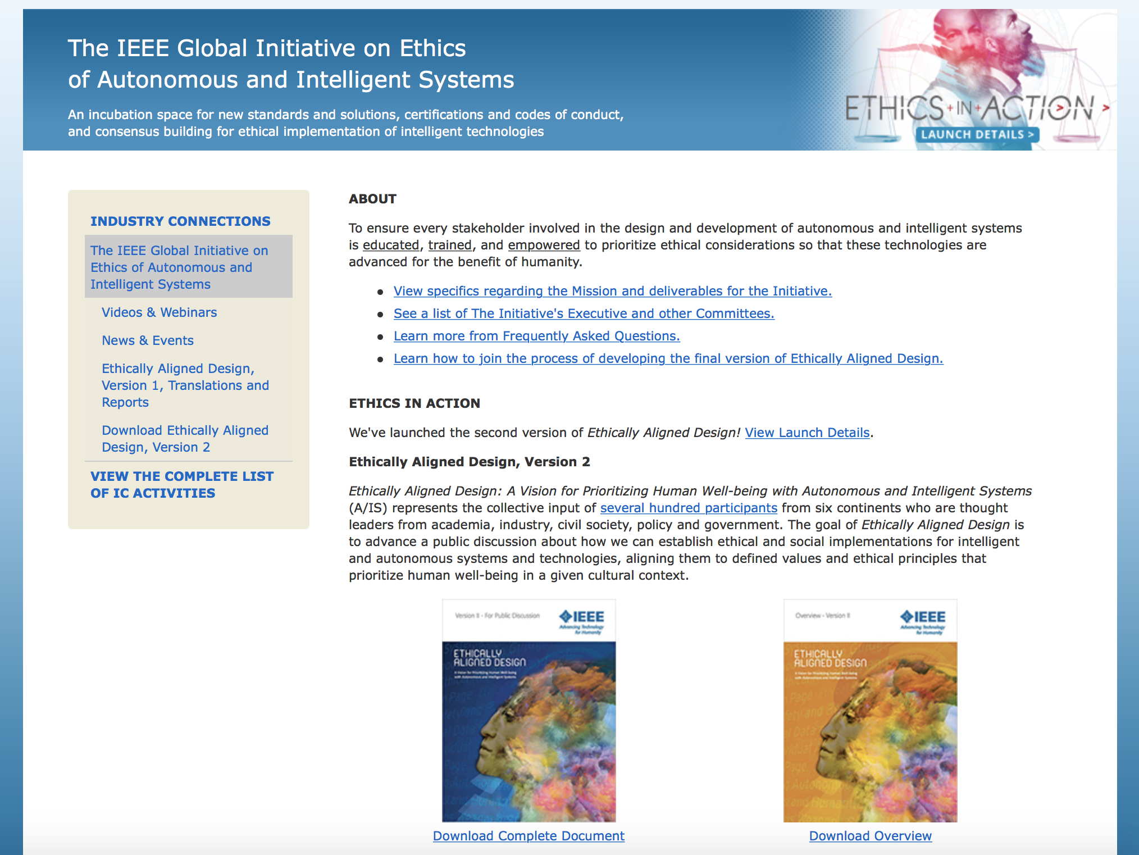
The IEEE Global Initiative on Ethics of Autonomous and Intelligent Systems
http://standards.ieee.org/develop/indconn/ec/autonomous_systems.html
Mission
To ensure every technologist is educated, trained, and empowered to prioritize ethical considerations in the design and development of autonomous and intelligent systems.
Human well-being is the highest virtue for a society, and human flourishing begins with conscious contemplation.

Slide 28
Human Rights in the Robot Age
AI/Robotics not Aligned Ethically to Human’s Values and Rights
Human Dignity
Objectification
Right to a decent standard of Living
Increase of Social Gap
Freedom of Expression
Interference in the Information Received
Future World
Prohibition of Discrimination
Segregation/Misogyny
Right to Life
Life and death decision machines
(Not only LAWS/AWS)
Right to enjoy possessions
Ownership of Personal Data
Right to respect for Privacy
Loss of Privacy
28￼
Right to respect for Family Life
Social Deskilling
Right to respect for private life
Manipulation of Choices
Right to a decent standard of living
Environmental Degradation
Right to cultural life and expression
Disappearance of traditional cultures
Access to justice and the right to a fair trial
Bias in the decision
Notes:
Dependency and bonding : depression, isolation from others, manipulation (vulnerable people);
Minimization of expert authority and misused for profit : finalizing tool to minimize hospital costs.
Loss of data privacy and protection : misused user information collected by robots at home, drones,..
Destruction of private properties: drones falling and damaging private properties or hurting human/animals,
Stigmatisation and degradation: sexual robots being abused;
Immoral behaviors becoming moral ones: slavery, rape, pedophilia - replication of abnormal behaviors in the society.
Diminishing of empathy and stimulation of aggressive behaviors, like in violent games
Responsibility in failures cases: accountability, transparency
…..

Slide 29
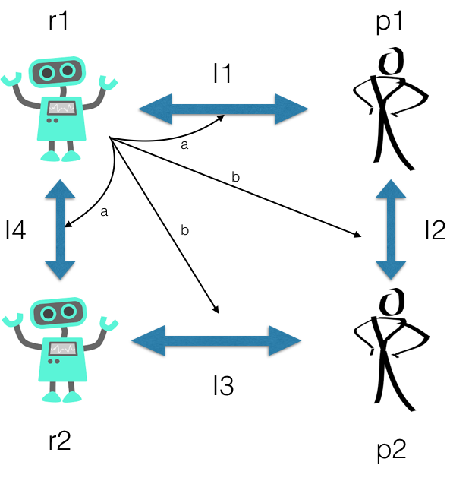
Social Values in Human-Robot Interaction
Communication
Language (speech,..)
Paralanguage (kinesics, tone, proximity,..)
Dimensions
Socioeconomic Status
Legal Status
Culture
Religion
Generation
Gender
Environment
Business
Home
Government
Social
Foreign
School
a: direct communication/exchange information
b: see, analyze, learn and influence

Slide 30
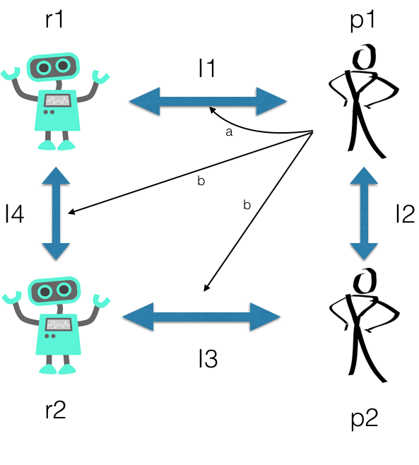
Social Values in Human-Robot Interaction
Communication
Language (speech,..)
Paralanguage (kinesics, tone, proximity,..)
Dimensions
Socioeconomic Status
Legal Status
Culture
Religion
Generation
Gender
Environment
Business
Home
Government
Social
Foreign
School
a: direct communication/exchange information
b: see, analyze, learn and influence

Slide 31
Human Values and Principles implicated in System Design
Human Welfare
Freedom From Bias
Autonomy
Trust
Informed Consent
Child Protection
Environmental Sustainability
Distinction
Proportionality
Accountability
Responsibility
Transparency
Safety
Universal Usability
Notes:
Informed encompasses disclosure and comprehension. Disclosure refers to providing accurate information about the benefits and harms that might reasonably be expected from the action under consideration. Comprehension refers to the individual accurate interpretation of what is being disclosed. The idea of consent encompasses voluntariness, comprehension and agreement. Voluntariness refers to ensuring that the action is not controlled or coerced.
Human Welfare: people's physical, material, and psychological well-being
Privacy: a right of an individual to determine what information about himself or herself can be communicated to others
Freedom From Bias: refers to systematic unfairness perpetrated on individuals or groups, including pre-existing social bias, technical bias, and emergent social bias
Universal Usability: making all people successful users of information technology
Autonomy: people's ability to decide, plan, and act in ways that they believe will help them to achieve their goals
Informed Consent: refers to garnering people's agreement, encompassing criteria of disclosure and comprehension (for informed) and voluntariness, competence, and agreement (for consent)
Accountability: ensures that the actions of a person, people, or institution may be traced uniquely to the person, people, or institution.
Environmental Sustainability: Refers to sustaining ecosystems such that they meet the needs of the present without compromising future generations

Slide 32
How to connect them ?
Systems/Robots
Moral Values
Direct/Indirect stakeholders
(Manufacturers, end-users,..)
Ethical Values
National Hard/Soft Laws
Ethical Issues
Solutions
International Hard/Soft Laws
Human well-being measures
Ecosystem
Regulators/Lawmakers
Notes:
Income, health, public services, leisure, mobility

Slide 33
..to answer questions like
What are the ethical issues ?
How to address them?
Who can address them?
What values are involved in these issues ?
What norms are being violated?
Who will be impacted directly by the issue?
Who is responsible in case of failures?
How a solution impacts human well-being? Is it possible to improve it?
What metrics we can use to measure human well-being? income? health? leisure?
How does the solution/issue impact the environment?
How can we implement a solution?

Slide 34
Future Standard : IEEE P7007
Applications
a guide for teaching ethical design;
a reference by policy makers and governments to draft AI related policies;
a common vocabulary to enable the communication among government agencies and other professional bodies around the world;
a framework to create systems that can act ethically; and
a foundation for the elaboration of other ethical compliance standards.
Stakeholders
Manufacturers, service and solution providers, equipment suppliers in the robotics and users.

Slide 35
Future Standard : IEEE P7007
Currently, our group more than 120 members from
Brazil, Portugal, USA, United Kingdom, Hungary, Italy, Norway, Canada, Spain, France, Greece, Switzerland, Germany, Spain, Sweden, Nederland, Malaysia, China, Egypt, Bangladesh, Israel

Slide 36
Future Standard : IEEE P7007
Main Groups
Robot Ethics KR SG: This subgroup will review the theoretical aspects that characterise ethics in R&A and propose models to represent them. It is the main ontology group;
Ethical Robot Design SG: This subgroup will produce guidelines and models to take into account ethical concerns in general robot design, from simple automatons to highly autonomous systems;
Ethical Violation Management SG: This subgroup will produce a set of guidelines and models to assess and correct ethical violations in robot behaviour. This might also include aspects regarding transparency, accountability and responsibility.

Slide 37
Future Standard : IEEE P7007
Transversal Subgroups
Transparency : guidelines and models to regulate transparency in robots.
Data privacy and protection: guidelines and models to regulate data privacy and protection in robots.
Full Moral Robots: guidelines and models to design and operate robots which actively adapt their behavior according ethical notions.
Law: guidelines and models to assess accountability and responsibility, taking into account law and regulations.
Ethical use of robots: guidelines and models for the ethical use of robots (i.e. taking into account the impact in economics, tax and politics).

Slide 38
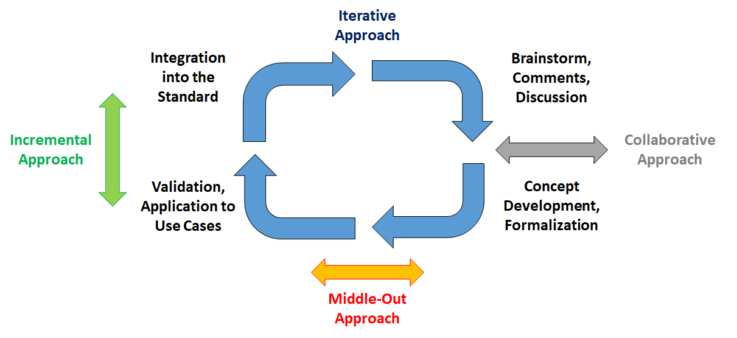
Robotic Ontological Standard Life Cycle
Future Standard : IEEE P7007
The flow of information and developed knowledge in between the Subgroups are set to be horizontal rather than hierarchical.

Slide 39
Future Standard : IEEE P7007

Slide 40
Future Standard : IEEE P7008
Name
Standard for Ethically Driven Nudging for Robotic, Intelligent and Autonomous Systems
Purpose
"Nudges" as exhibited by robotic, intelligent or autonomous systems are defined as overt or hidden suggestions or manipulations designed to influence the behavior or emotions of a user. This standard establishes a delineation of typical nudges (currently in use or that could be created). It contains concepts, functions and benefits necessary to establish and ensure ethically driven methodologies for the design of the robotic, intelligent and autonomous systems that incorporate them.
Chair: Laurence Devillers (Paris-Sorbonne IV, France)

Slide 41
Related IEEE Initiatives
P7000 - Model Process for Addressing Ethical Concerns During System Design;
P7001 - Transparency of Autonomous Systems;
P7002 - Data Privacy Process;
P7003 - Algorithmic Bias Considerations
P7004 - Standard for Child and Student Data Governance
P7005 - Standard for Transparent Employer Data Governance
P7006 - Standard for Personal Data Artificial Intelligence(AI) Agent
P7008 - Standard for Ethically Driven Nudging for Robotic, Intelligent and Autonomous Systems
P7009 - Standard for Fail-Safe Design of Autonomous and Semi-Autonomous Systems
P7010 - Wellbeing Metrics Standard for Ethical Artificial Intelligence and Autonomous Systems
Notes:
Ethical issues no centro..
Quem pode atacar, regular, quem é afetado, ..
soluções

Slide 42
How to get in touch
Email:edson.prestes@ieee.org.
Phone: +55 51 3308-7127
My homepage: http://www.inf.ufrgs.br/~prestes
Linkedin: https://www.linkedin.com/in/edson-prestes/

